Slide 1
Portfolio Orientation
Training Operations
Notes:
Hi my name is William Blair and I’m a Training Operations Specialist at Revature. As of Tuesday February 21st I have been at Revature for 1 year, and I started right where you are. First off congratulations on getting to where you are now. Im sure I don’t need to tell you about our in depth screening and training processes.

Slide 2
What is a portfolio?
Importance of portfolio.
How to create your own portfolio?

Slide 3
Sample Portfolio
https://app.revature.com/dashboard
https://app.revature.com/editportfolio/My%20Portfolio

Slide 4
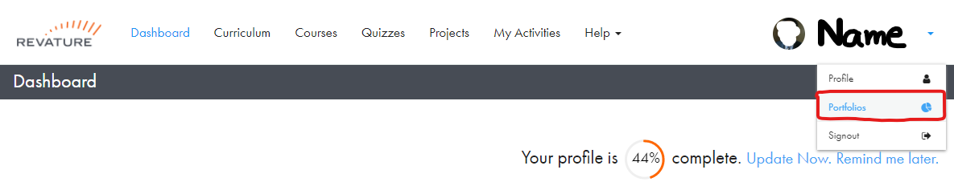
Setup Your Portfolio
Login to RevaturePro
Go to “Portfolios”
Click on “Create Portfolios”
Note: you may need to update your “Profile Name” before you can create your portfolio
Notes:
2. First thing check that your name is spelled and presented correctly, this is mostly a reference to hyphenations and preferred names.

Slide 5
Setup Your Portfolio
Enter a name for your portfolio
This does NOT appear on the published version of the portfolio
Use the convention {{First Name-Last Name}}
E.g. “Andrew-Crenwelge”
Fill out the portfolio according to the guidelines.
Notes:
Create your name in Pascal case or Camel case, showcase what your learning.
By adhering to the guidelines we help to ensure that when the client gets your portfolio they know where to consistently look for the information thats relevant for them.

Slide 6
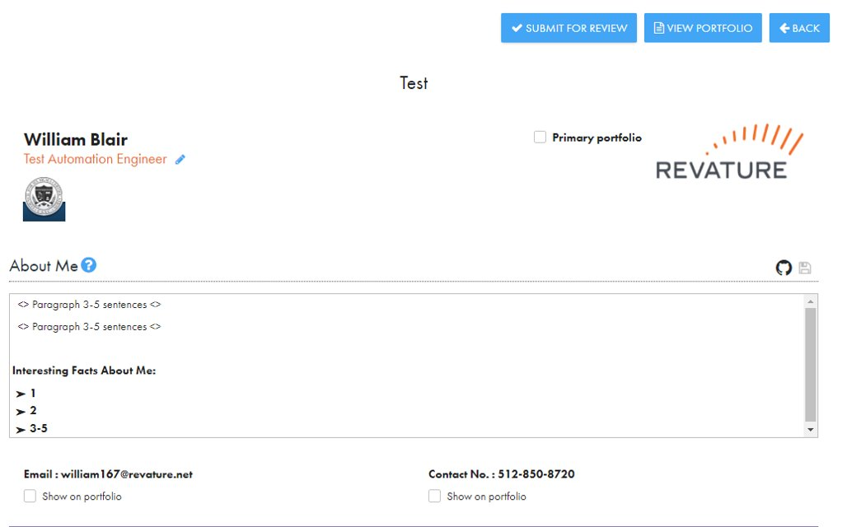
Adding Title & About Me
Notes:
About me section
Showcase yourself
Use as a script
Helps with anxiety and other pressures of interviews

Slide 7
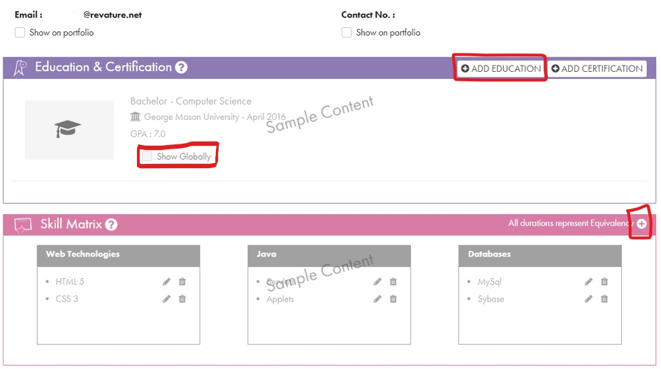
Adding Education & Skills Matrix
Notes:
GPA
Show globally – highest education

Slide 8
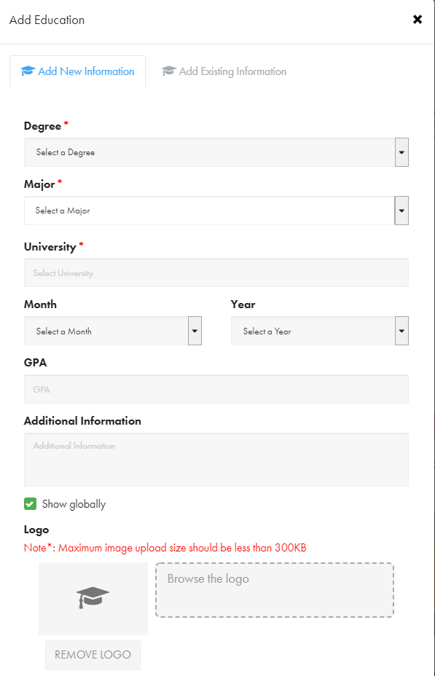
Education Details

Slide 9
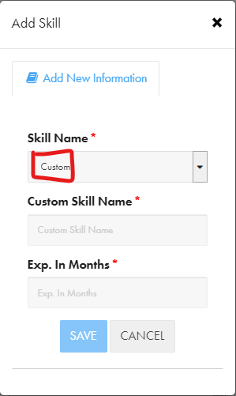
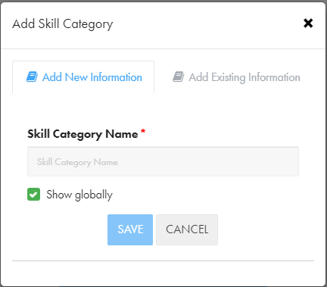
Skills Matrix
Notes:
3-6 months
Showcase your individual skills

Slide 10
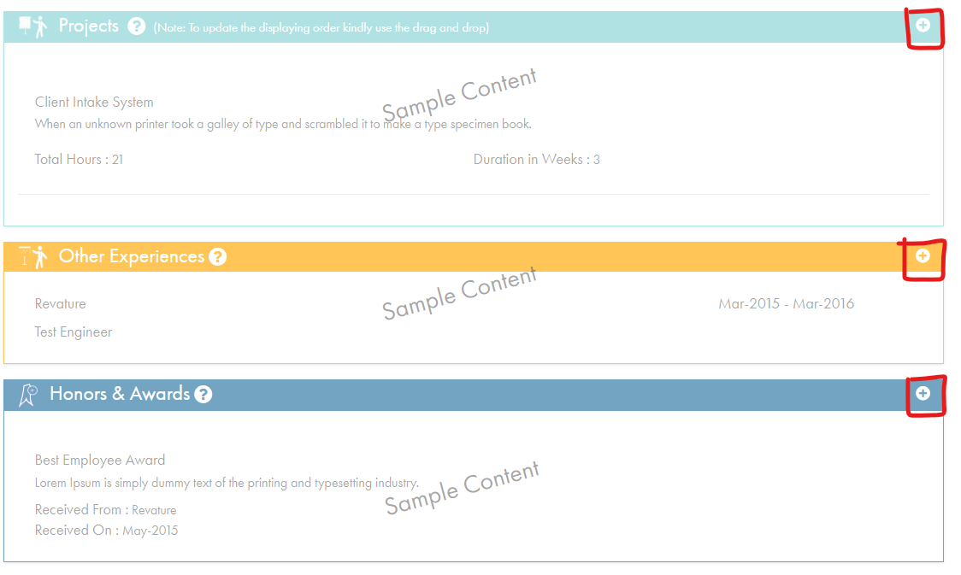
Adding Projects, Other Experiences, and Honors
Notes:
Roles and responsabillities

Slide 11
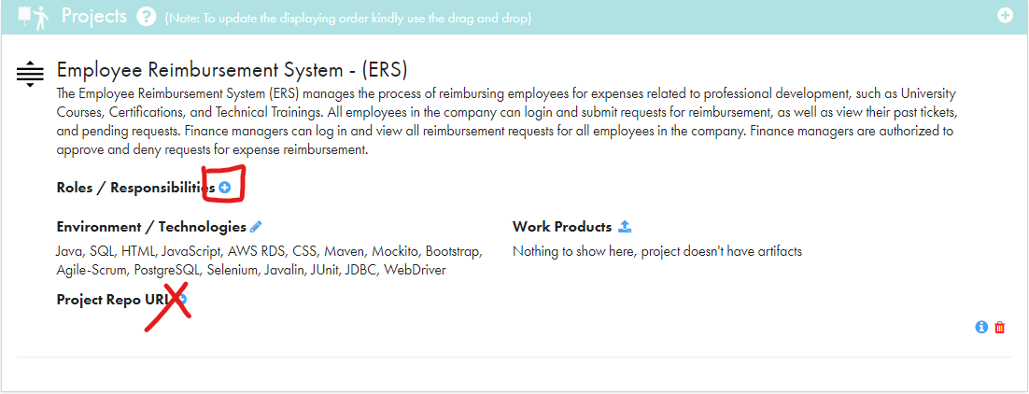
Project Bullet Points

Slide 12
Remember…
Avoid grammatical and spelling mistakes in about me, make it crisp and clear(Use Grammarly Plugin)
Kalai do the initial Phase 1, Phase 2 and Reethu does the final reviews.
Before you submit your portfolio, proof read it for formatting, grammar, and spelling mistakes.
You cannot edit your portfolio after you submit it; you must wait for feedback.
Check your revature.net email for updates, reminders, and feedback.
Do NOT clone your portfolio unless asked to do so.
If you have questions or doubts, kindly reach us through email or teams.

Slide 13
Review Process
YES
Phase 1 Work
Name & Title
About Me
Education & Certification
Other experience
Project 0
Create Portfolio
Corrections?
Submit for Review
NO
Training Ops to Ops Manager
Phase 2 Work
Project 1,2
Skills Matrix
Corrections?
Submit for Review
NO
Published by Ops Manager
Portfolio Appears as “Approved”
Link sent to Sales and Delivery teams for sharing with client
YES

Slide 14
Deadlines
Phase 1 submission: Wed,7/24/2024
Phase 2 submission: Wed,7/31/2024
The final due date for submission is: 8/7/2024

Slide 15
Questions?

